Slide 1

two sum
Lkhagva-Ochir, 202339663
Software Engineering

Slide 2
description
Given an array of integers nums and an integer target, return indices of the two numbers such that they add up to target.

Slide 3
example
nums = [2, 4, 6, 1, -9] target = 10
0 1 2 3 4
x + y = 10
4 + 6 = 10
answer: [1, 2]

Slide 4
example
nums = [2, 4, 6, 1, -9] target = 10
0 1 2 3 4
x + y = 10
4 + 6 = 10
answer: [1, 2]
x + y = target
y = target - x
y = 10 - 2
y = 8 (X)
y = 10 - 4
y = 6 (O)
answer: [1, 2]

Slide 5
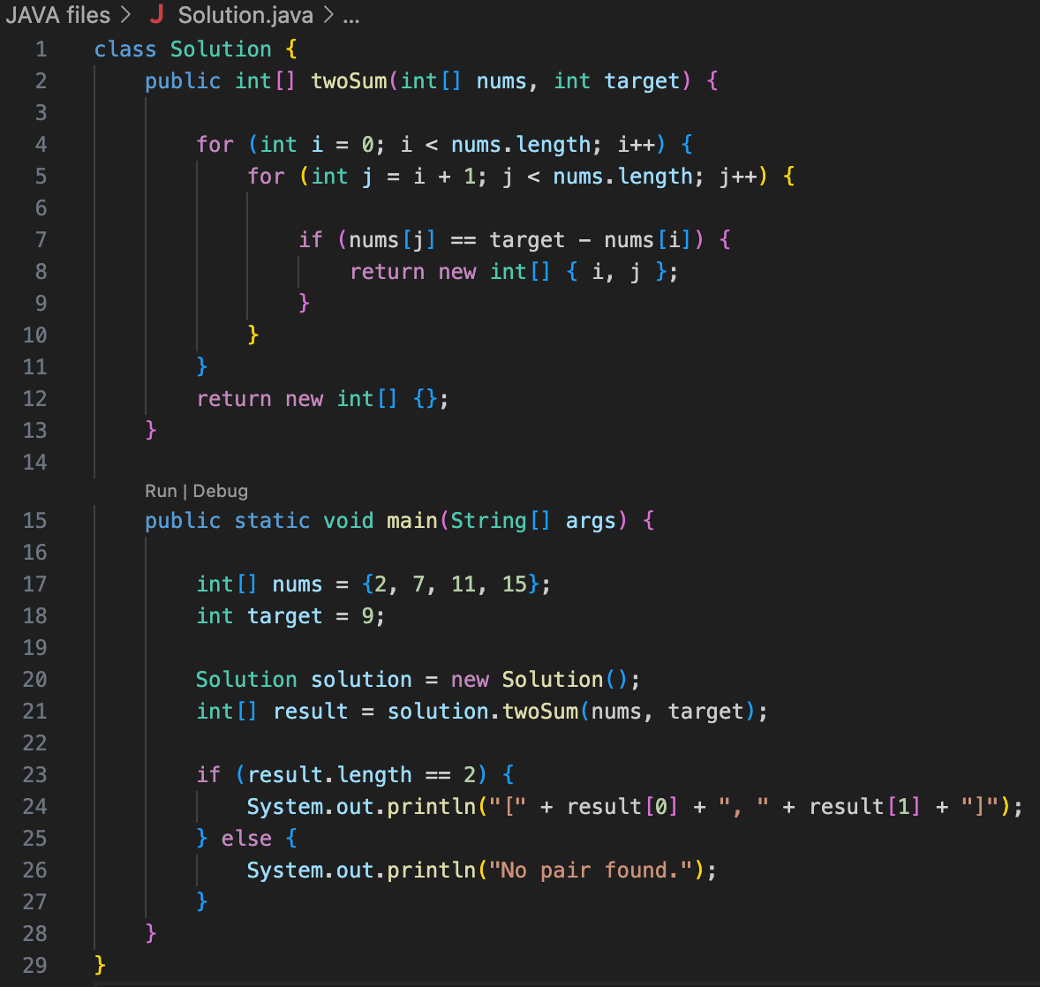
implementation

Slide 6
thank you

